Slide 1
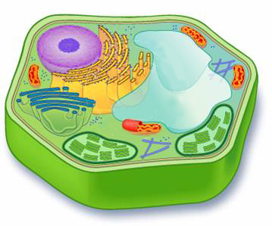
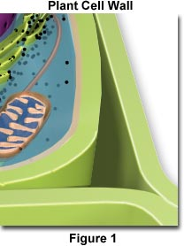
Cell wall :
Let us go to the next part
Found ONLY in plant cells
It is a rigid outer covering of the cell
It is present outside the cell membrane
It is made up of cellulose
Cellulose is a complex substance and provides structural strength to plants.
Allows all substances to enter and leave the cell freely
A type of carbohydrate
It is non living and freely permeable

Slide 2
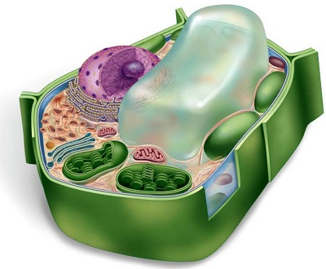
Functions of cell wall :
But the cell wall exerts an equal pressure against the swollen cell.
Gives protection to the cell
We have seen that when a cell is placed in a hypotonic solution, it absorbs water and swells due to osmosis.
The cell swells, building up pressure against the cell wall.
So there are chances that the cell might burst because of the pressure.
Gives definite shape to the cell
Because of this the cell can withstand greater pressure.

Slide 3


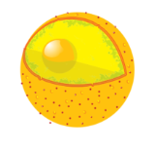
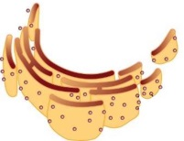

Cytoplasm :
It is a jelly-like fluid inside the cell.
It lies between plasma membrane and nucleus.
Many cell organelles lie in the cytoplasm.
Cytosol
All the cellular chemical reactions take place in the cytoplasm.
It stores vital substances like amino acid, glucose, vitamins etc.
The part of cytoplasm other than the organelles is called cytosol.

Slide 4
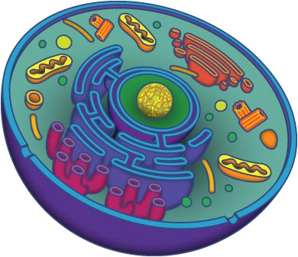
Cell organelles :
An organelle is a specialised subunit within a cell that has a specific function.
Organs of the cell
Example, making new material in the cell, clearing up the waste material from the cell, etc.
A cell is able to live and perform all its function because of these organelles.
All the cell have the same organelles, no matter what their function is or what organism they are found in.
Let us see them one by one

